Slide 1
Oracle Data Integrator (ODI)
Subtítulo

Slide 2
Introduction to ODI
Is a comprehensive data integration platform that covers all data integration requirements: from high-volume, high-performance batch loads, to event-driven, trickle-feed integration processes, to SOA-enabled data services;
ODI12c further builds on its flexible and high-performance architecture with comprehensive big data support;
And Parallelism when executing data integration processes.

Slide 3
Overview ETL – ELT

Slide 4
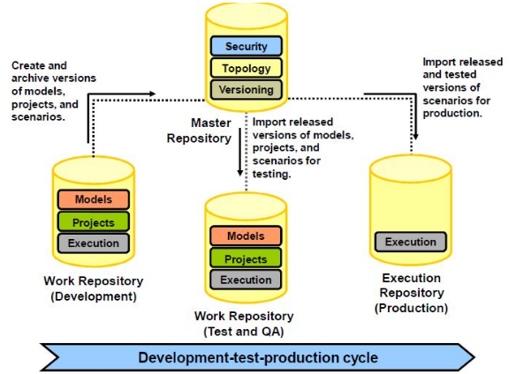
Architecture ODI

Slide 5
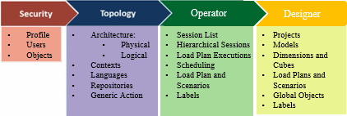
Título e Layout de Conteúdo com SmartArt

